Slide 1



CODE CARNIVAL 3.0
ATMIYA DEVELOPER STUDENTS CLUB PRESENTS
Idea Submission Template · The Heist Plan
TEAM NAME
TEAM ID
TEAM LEADER
Team Dashanan
JZ8M
Saurabh Singh
PROBLEM STATEMENT TITLE
THEME / TRACK
Ai Urban Farming Assistant
Software , IOT
Notes:
Title slide. Replace every bracketed field. Do not move or resize the logos.

Slide 2
PROBLEM STATEMENT & UNDERSTANDING
01 · THE TARGET
PROBLEM STATEMENT
OUR UNDERSTANDING
Problem: Plant disease detection, watering, and care challenges.
Affected Users: Home gardeners and small farmers.
Impact: Plant loss, water waste, and reduced sustainability.
Root Cause: Lack of expert, personalized plant-care guidance.
Solution Gap: No single tool for complete plant care.
Why Now: AI and weather APIs enable smart, instant plant-care advice.
Code Carnival 3.0 · ADSC, Atmiya University
Team Dashanan

Slide 3
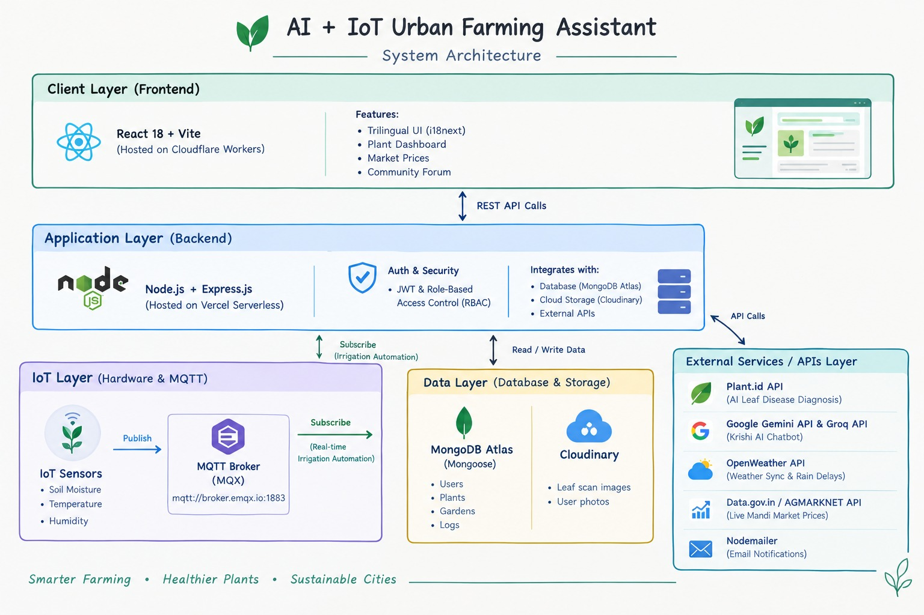
PROPOSED SOLUTION
02 · THE PLAN
OUR IDEA
AI Farming Assistant: Disease diagnosis and personalized plant care.
Workflow: Upload → Diagnose → Treat → Water → Track.
Key Features: AI diagnosis, smart watering, plant tracking, mandi prices, and multilingual support.
Target Users: Home gardeners, urban growers, and local farmers.
Code Carnival 3.0 · ADSC, Atmiya University
Team Dashanan

Slide 4
KEY FEATURES / FUNCTIONALITY
03 · THE ARSENAL
01
Ai Plant Disease Diagnosis
02
Weather-Based Smart Irrigation
Upload a leaf image to identify common plant diseases and receive instant treatment recommendations. Helps gardeners detect problems early and protect their plants
Combines plant growth stage with live weather data to recommend watering frequency and delay irrigation when rain is expected, reducing unnecessary water use.
03
Plant Health Tracking
04
Krishi AI Assistant
Track plants, growth stages, planting dates, photos and health scores in one place, with reminders for watering, fertilizing and pruning.
Get personalized farming guidance through an AI assistant supporting English, Hindi and Gujarati, including pest control, soil, irrigation and plant-care queries.
Code Carnival 3.0 · ADSC, Atmiya University
Team Dashanan]

Slide 5

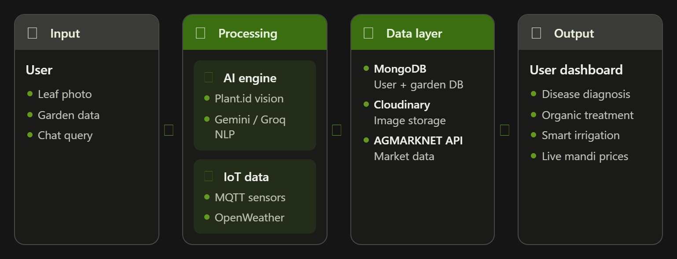
HOW THE SOLUTION WILL WORK
04 · THE EXECUTION
STEP 1
STEP 2
STEP 3
STEP 4
Upload Image Or Text
Processing by AI / IOT
Virtual ESP32 , Sensior
Diagnosis & Cure
Code Carnival 3.0 · ADSC, Atmiya University
Team Dashanan

Slide 6
TECHNOLOGY / TECH STACK
05 · THE GEAR
Layer | Technology | Why we chose it
Frontend | React 18 + Vite + React Router | Fast, responsive & component-based UI
Backend | Node.js + Express.js | Lightweight REST APIs & scalable backend
Database | MongoDB + Mongoose | Flexible storage for plants, users & gardens
AI / APIs | Gemini,Plantid,GroqAi,OpenWeather | AI diagnosis, smart care & live data , Accurate Response
Hosting | Cloudflare Workers + Vercel | Fast frontend & serverless backend deployment
Tools | Git/GitHub + Cloudinary + i18next + IOT | Version control, media storage & localization, Sensor
Code Carnival 3.0 · ADSC, Atmiya University
Team Dashanan

Slide 7
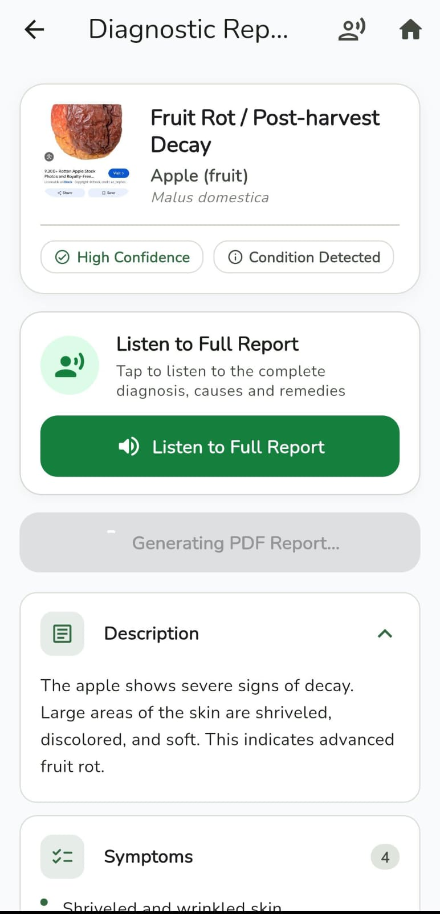
CURRENT PROGRESS / WORK DONE
06 · INSIDE THE MINT
COMPLETED
IN PROGRESS
AI Plant Diagnosis: Disease detection and organic treatment recommendations.
Smart Irrigation: Weather-based watering and rain alerts.
Plant Tracking: Growth monitoring and care reminders.
IoT Integration: Real-time sensor monitoring on web and mobile apps.
Multilingual AI Assistant: English, Hindi, and Gujarati support.
Gamification & Community: XP rewards, badges, grower discussions, and seed exchange.
AI Voice Assistant: Voice-based farming guidance.
AI Calling Agent: Automated care reminders and alerts.
Real-World IoT: Live physical sensor monitoring on web and mobile.
Code Carnival 3.0 · ADSC, Atmiya University
Team Dashanan

Slide 8
FUTURE PLAN / NEXT STEPS
07 · THE GETAWAY
PHASE 1
PHASE 2
PHASE 3
DURING THE HACKATHON
RIGHT AFTER
LONG-TERM VISION
Complete: Real ESP32 + MQTT IoT integration
Testing: Disease detection, irrigation & AI recommendations
Demo Goal: End-to-end Plant → Diagnose → Treat → Water → Track
Improve: AI accuracy, IoT reliability & user experience
Add: Advanced plant-health analytics & automated irrigation
Pilot: Test with real urban gardeners and collect feedback
Scale: Connect multiple gardens with IoT-based monitoring
Impact: Reduce water waste & improve urban crop health
Vision: Build a scalable AI + IoT smart urban farming ecosystem
Code Carnival 3.0 · ADSC, Atmiya University
Team Dashanan

Slide 9

GITHUB REPOSITORY LINK
08 · THE VAULT
Hint (delete): paste the full link as clickable text and check it opens without signing in.
https://github.com/mr-baraiya/UrbanFarm
PUBLIC
README
COMMITS
DEMO (OPTIONAL)
Repository visibility is set to public.
Covers setup steps, features and team members.
Regular commits from every team member.
https://urbanfarm.baraiyavishalbhai32.workers.dev/
Code Carnival 3.0 · ADSC, Atmiya University
Team Dashanan

